Slide 1

Contributory Market Insights Alerts
Fido Analytics

Slide 2
Agenda
Alerts types
Alerts level
Alerts calculation
Floor selection
Fido Analytics

Slide 3
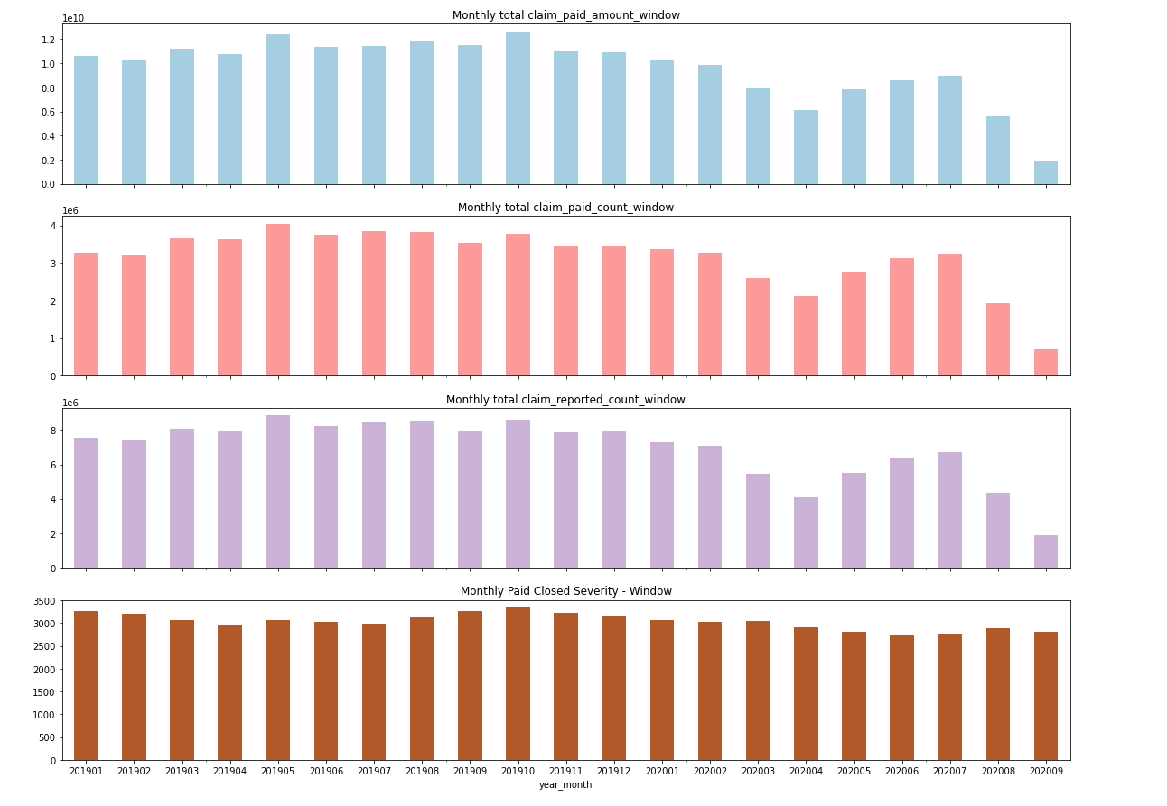
Impact of Covid-19
APR 2020
The data is heavily impacted by Covid-19, thus need to treat the data from Apr-2020 to Sep-2020 separately

Slide 4
Alerts Types
8 Alerts in total
Two types of alerts(high value alerts and low value alerts) in 4 categories:
Category | Calculation | Alerts Type | Alerts Type
Closed counts | claim_paid_closed_count_window | Low closed counts | High closed counts
Reported counts | claim_reported_count_window | Low reported counts | High reported counts
Severity | paid_closed_claim_amount_window / claim_paid_closed_count_window | Low severity | High severity
Reported Frequency | claim_reported_count_window/earned exposure | Low frequency | High frequency

Slide 5
Alerts Level
Monthly Alerts
Based on past 5 months trend
On the level of coverage_type_sk, policy_state_sk, window_sk,shopgroup_sk, groupname
Category | Calculation | Alerts Type | Alerts Type
Closed counts | claim_paid_closed_count_window | Low closed counts | High closed counts
Reported counts | claim_reported_count_window | Low reported counts | High reported counts
Severity | paid_closed_claim_amount_window / claim_paid_closed_count_window | Low severity | High severity
Reported Frequency | claim_reported_count_window/earned exposure | Low frequency | High frequency

Slide 6

Alerts Advantages
Wide coverage
Detect both extremely low & high values
High accuracy
Every claim is different
Find the anomalies for each claim based on its past trend
Less impacted by seasonality
Months are rolling, thus the trend is moving forward every month

Slide 7
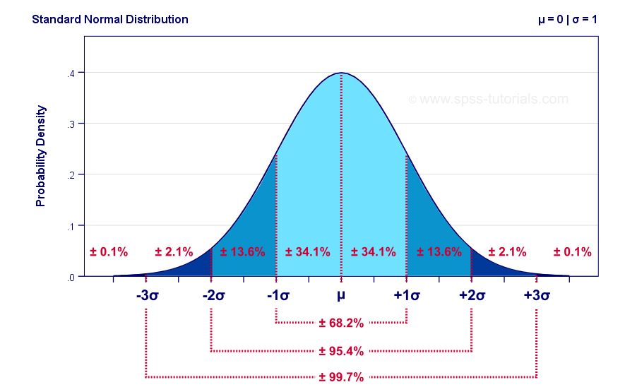
How to calculate alerts?
Months are rolling
Based on past 5 months trend, for each claim group by
coverage_type_sk, policy_state_sk, window_sk,shopgroup_sk, groupname
Current Month | Prior-1_month | Prior-2_month | Prior-3_month | Prior-4_month | Prior-5_month
Sep-2020 | Aug-2020 | Jul-2020 | Jun-2020 | May-2020 | Apr-2020
μ: past 5 months average
σ : past 5 months standard deviation
Set lower-bound: μ - 5 σ
Current month values < lower-bound is considered as low values
Set upper-bound : μ + 5 σ
Current month values > upper-bound are considered as high values

Slide 8
For example: claim_reported_count_window
Low value alert
policy_state_sk | window_sk | coverage_type_sk | shopgroup_sk | groupname | Current Month | Prior-1_month | Prior-2_month | Prior-3_month | Prior-4_month | Prior-5_month
4 | 2 | 3 | 143 | ATLANTA CASUALTY COMPANY | Sep-2020 | Aug-2020 | Jul-2020 | Jun-2020 | May-2020 | Apr-2020
 |  |  |  |  | 336 | 984 | 1080 | 1248 | 1224 | 1104
μ: past 5 months average： 1128
σ : past 5 months standard deviation：108.66
Set lower-bound : μ - 5 σ：584.68
Current month values < lower-bound will receive low value alert

Slide 9
For example: claim_reported_count_window
High value alert
 |  |  |  |  | Current Month | Prior-1_month | Prior-2_month | Prior-3_month | Prior-4_month | Prior-5_month
policy_state_sk | window_sk | coverage_type_sk | shopgroup_sk | groupname | Sep-2020 | Aug-2020 | Jul-2020 | Jun-2020 | May-2020 | Apr-2020
2 | 2 | 3 | 24 | AMERICAN NATIONAL PROPERTY & CASUALTY CO | 432 | 120 | 240 | 120 | 144 | 192
μ: past 5 months average： 163.2
σ : past 5 months standard deviation：52.03
Set upper-bound : μ + 5 σ：423.35
Values > upper-bound will receive high value alert

Slide 10
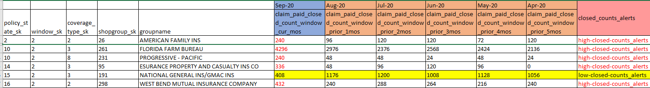
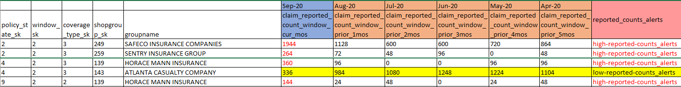
Looking into alerts
Should below closed_counts receive alerts?
Should below reported_counts receive alerts?
Fido Analytics

Slide 11
Setup floors
Summary table of volume variables
 | sum_closed_counts_5mos | sum_report_counts_5mos
count | 27398 | 27398
mean | 11543.33 | 23222.21
std | 54649.9 | 98201.27
min | 0 | 0
25% | 72 | 120
50% | 480 | 1080
75% | 3024 | 6600
max | 1420728 | 2134920
Setup floors based on the volumes:
Reported counts
Closed counts

Slide 12
Scenario 1
Scenario-1: floor based on 25% quantile value of volumes
Category | Floor | Type of Alerts | # of Alerts
claim_paid_closed_count_window | total closed counts in the past 5 months > 72 | high-closed-counts_alerts | 30
 |  | low-closed-counts_alerts | 3
claim_reported_count_window | total reported counts in the past 5 months > 120 | high-reported-counts_alerts | 31
 |  | low-reported-counts_alerts | 5
reported_frequency_window | Floor is based on reported counts and closed counts | high-freq-alerts | 113
 |  | low-freq-alerts | 7
paid_closed_severity_window | Floor is based on reported counts and closed counts | high-severity-alerts | 4
 |  | low-severity-alerts | 0
Summary table of volume variables
 | sum_closed_counts_5mos | sum_report_counts_5mos
count | 27398 | 27398
mean | 11543.33 | 23222.21
std | 54649.9 | 98201.27
min | 0 | 0
25% | 72 | 120
50% | 480 | 1080
75% | 3024 | 6600
max | 1420728 | 2134920

Slide 13
Scenario 2
Scenario-2: floor based on 50% quantile value of volumes
Category | Floor | Type of Alerts | # of Alerts
claim_paid_closed_count_window | total closed counts in the past 5 months > 480 | high-closed-counts_alerts | 13
 |  | low-closed-counts_alerts | 3
claim_reported_count_window | total reported counts in the past 5 months > 1080 | high-reported-counts_alerts | 16
 |  | low-reported-counts_alerts | 4
reported_frequency_window | Floor is based on reported counts and closed counts | high-freq-alerts | 72
 |  | low-freq-alerts | 6
paid_closed_severity_window | Floor is based on reported counts and closed counts | high-severity-alerts | 2
 |  | low-severity-alerts | 0
Summary table of volume variables
 | sum_closed_counts_5mos | sum_report_counts_5mos
count | 27398 | 27398
mean | 11543.33 | 23222.21
std | 54649.9 | 98201.27
min | 0 | 0
25% | 72 | 120
50% | 480 | 1080
75% | 3024 | 6600
max | 1420728 | 2134920

Slide 14
What’s next?
Finalize the cut-offs for the floor
Engineering implementation
Fido Analytics

Slide 15
Thank you!
Fido Analytics

